Slide 1
Regression Analysis on Basis Spread of Crude Oil
YICHAO IVAN DAI

Slide 2
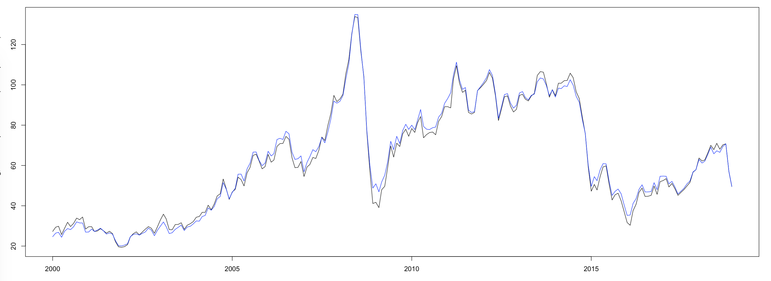
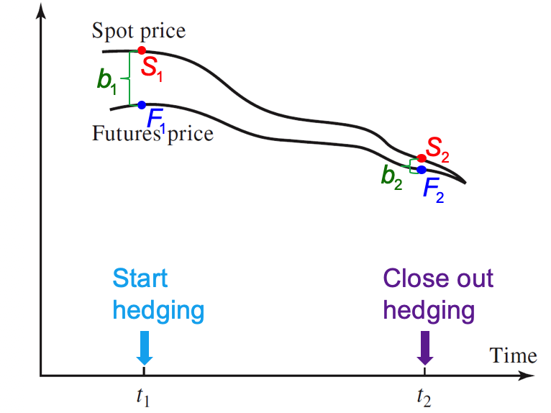
Incentive for the research
Hedgers can partly eliminate the basis risks or even gain some arbitrage profits by knowing the basis in advance.
Consequently, the basis should be zero at the maturity date. However, the basis may be positive or negative prior to maturity. Hence, explore the basis spread of WTI crude oil spot and futures price help investors who invest in WTI crude oil to eliminate some basis risks and minimize losses or even gain some arbitrage profit.

Slide 3
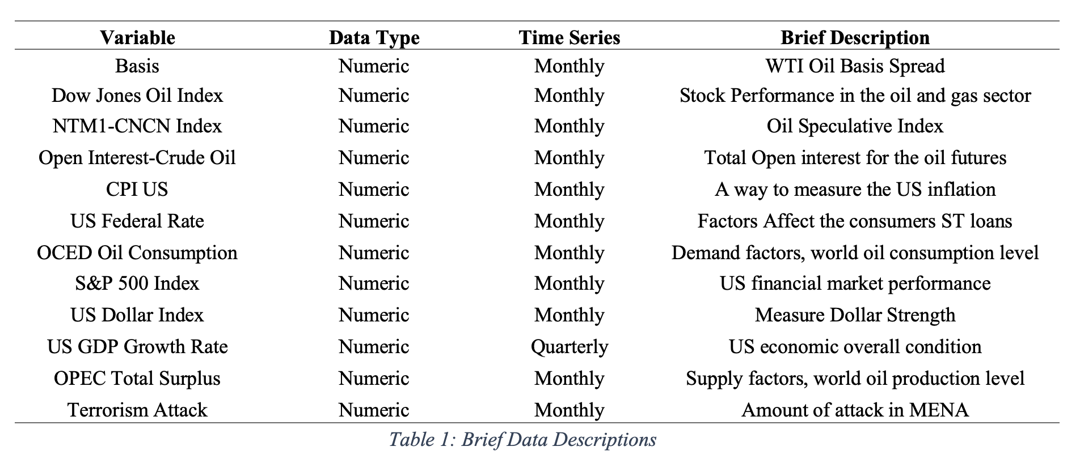
Data sources, Data description, Missing Value

Slide 4
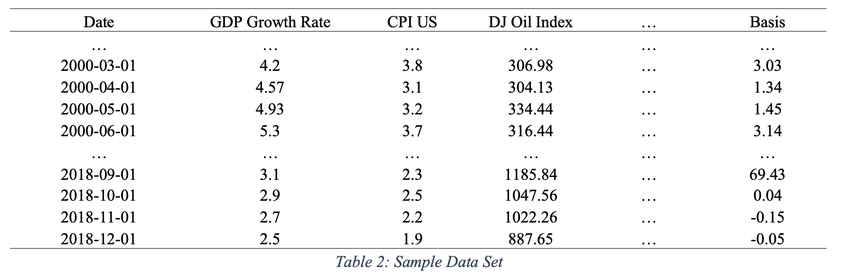
Data sources, Data description, Missing Value

Slide 5
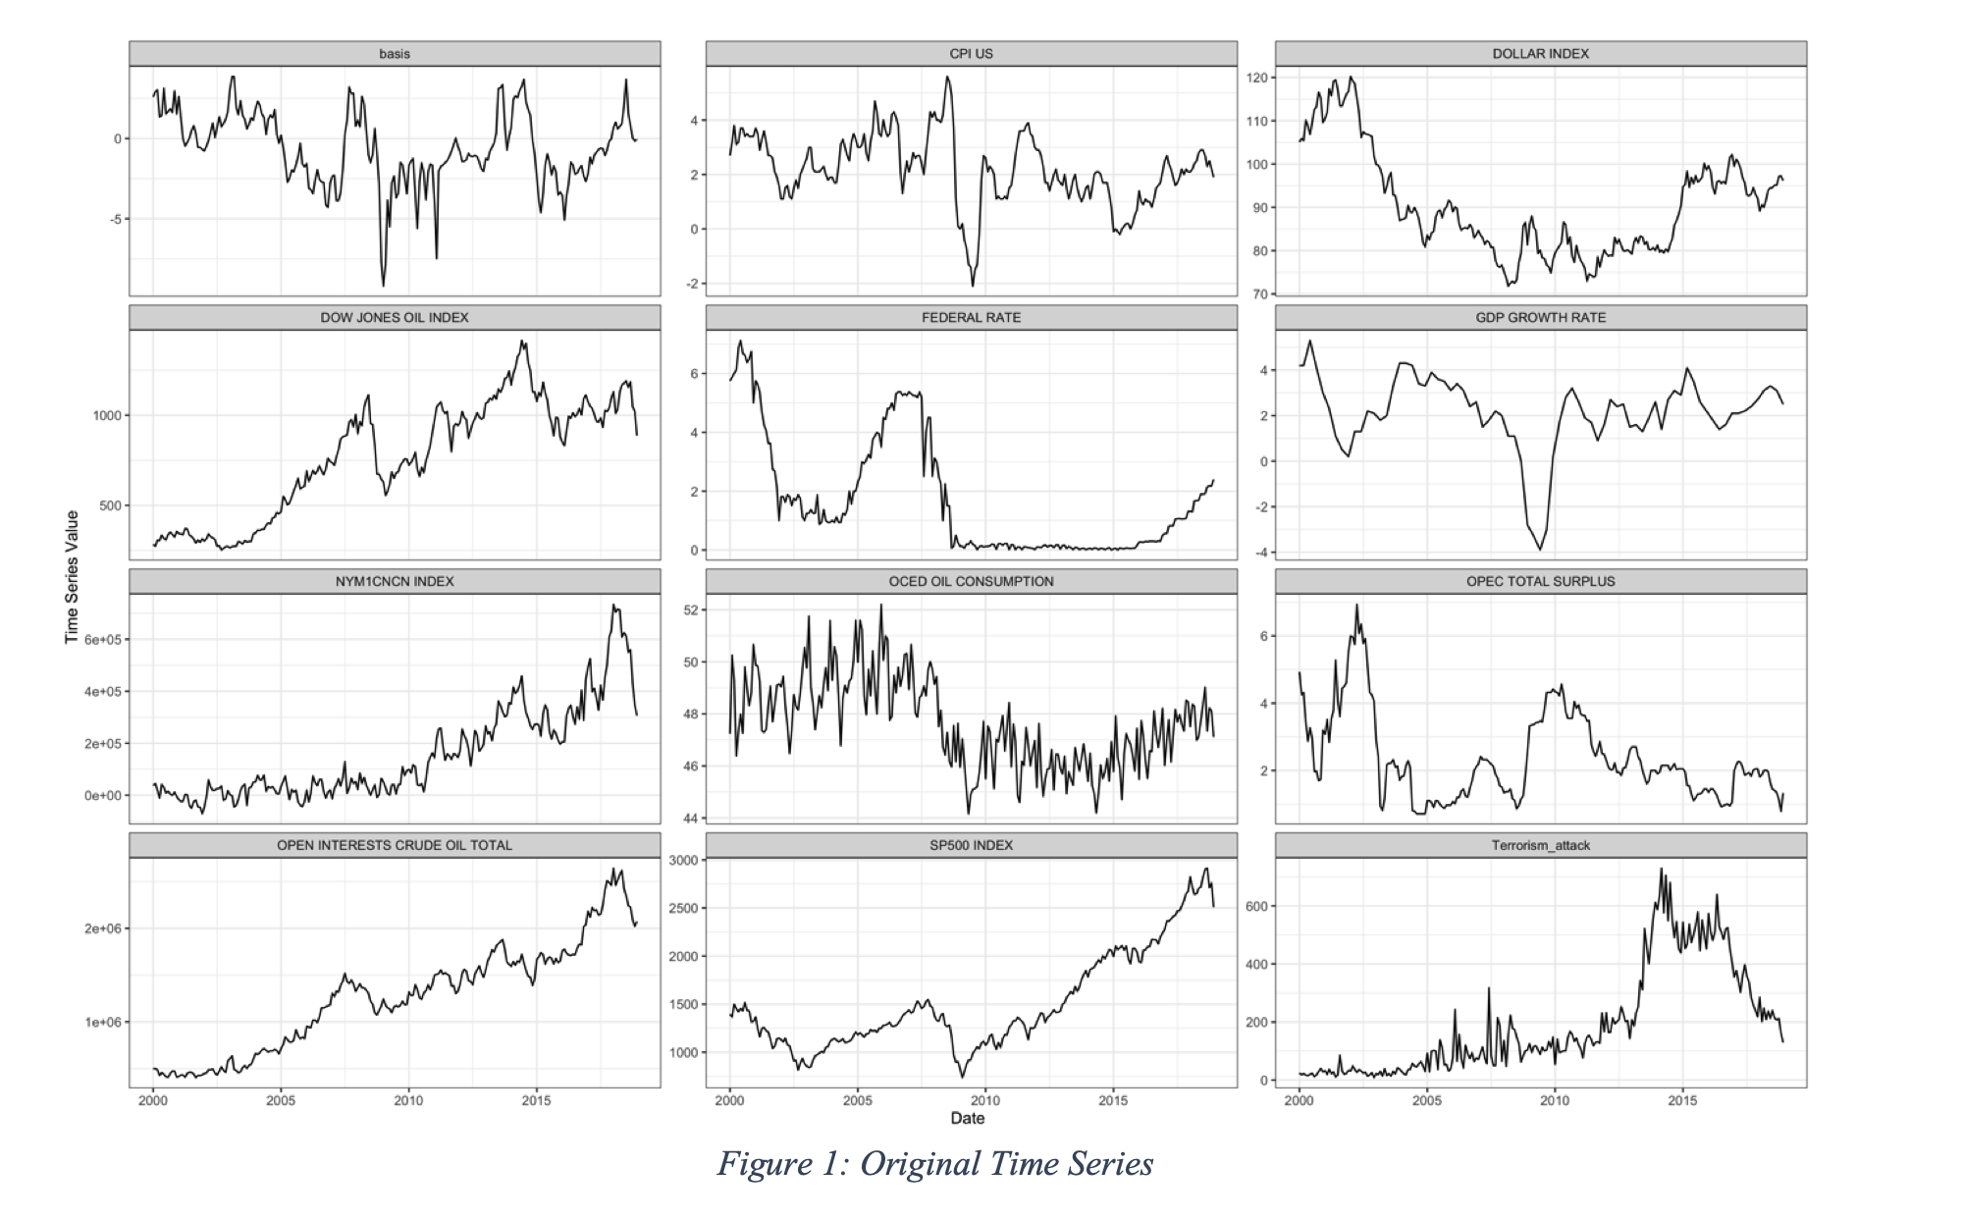
Unit Root Test / Cointegration Test

Slide 6
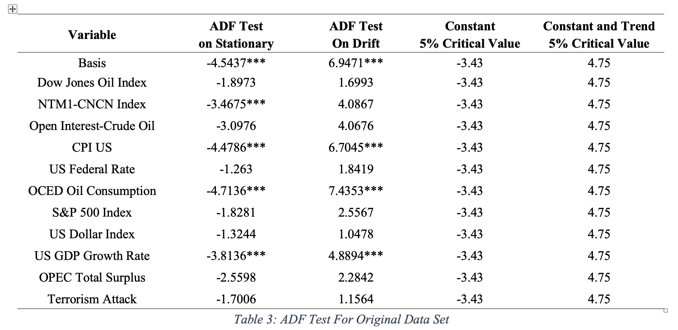
Unit Root Test / Cointegration Test

Slide 7
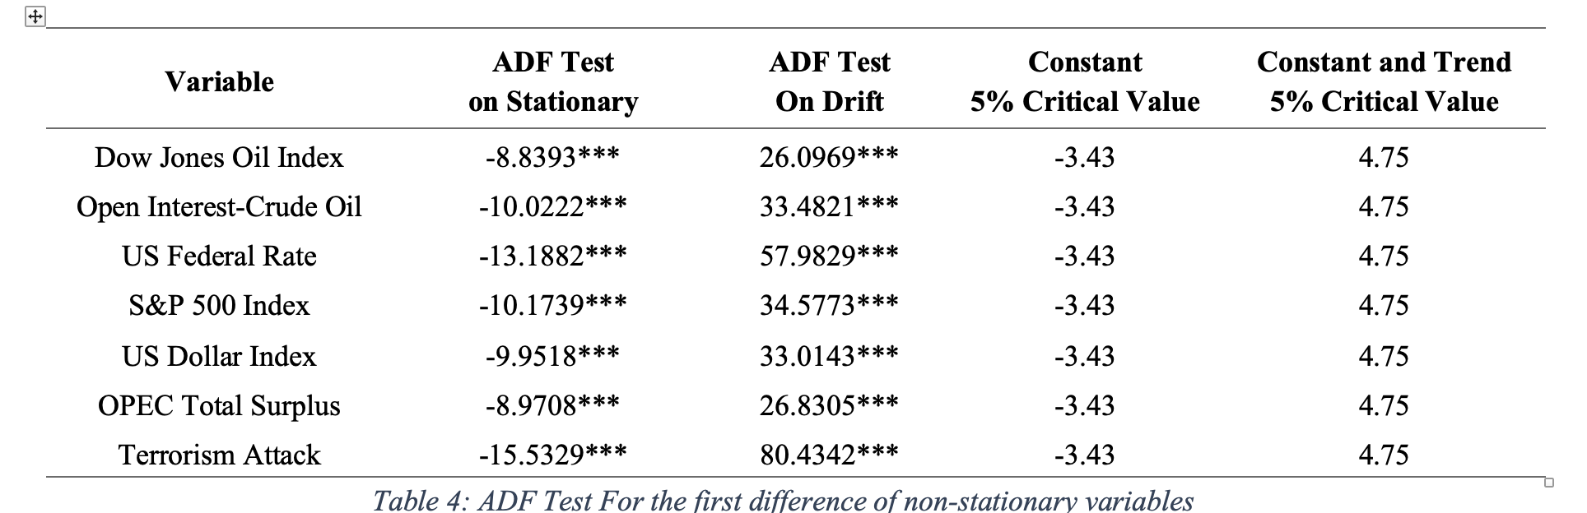
Unit Root Test / Cointegration Test

Slide 8
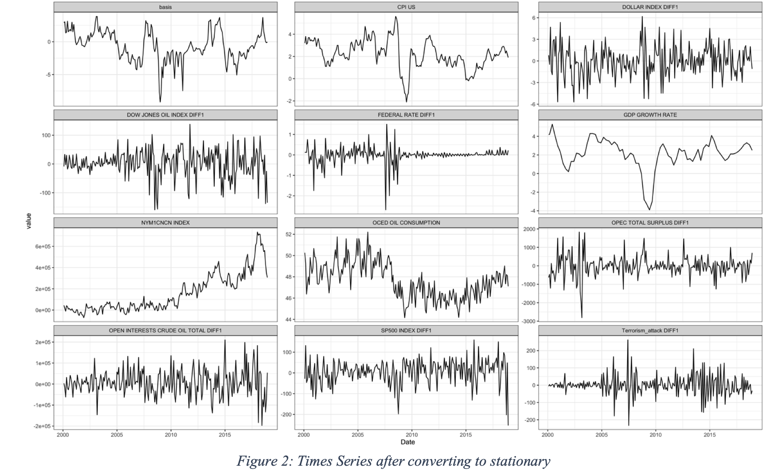
Unit Root Test / Cointegration Test

Slide 9
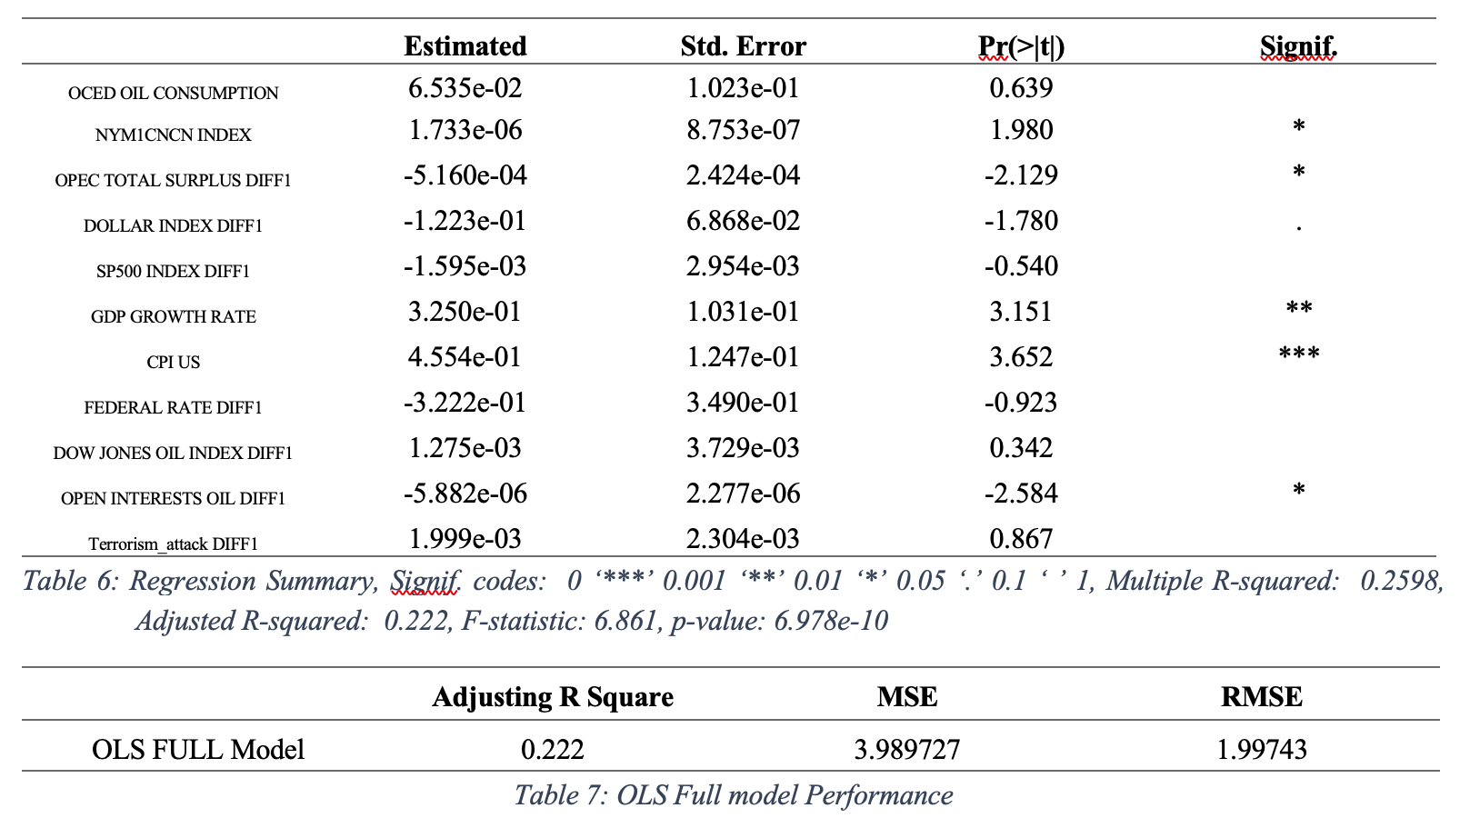
OLS FULL MODEL

Slide 10
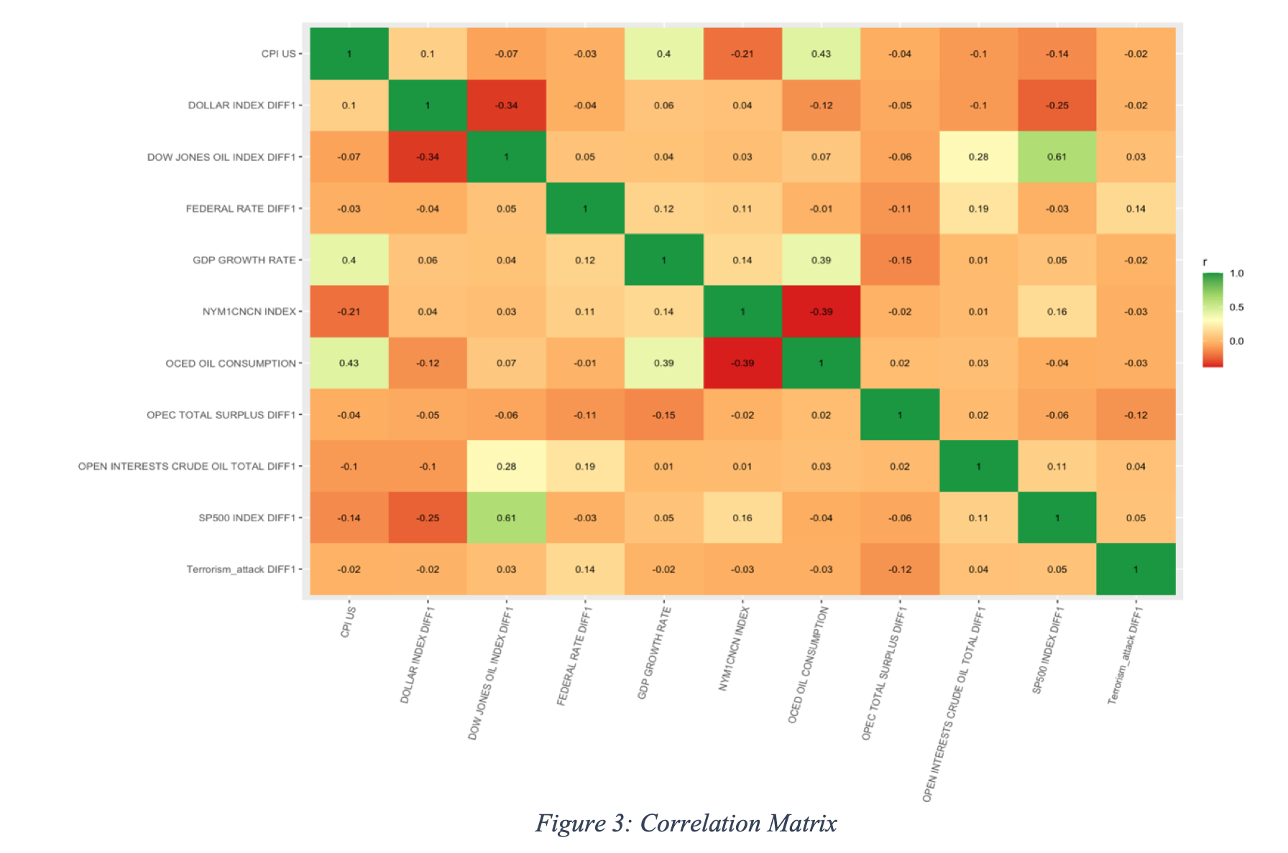
Model Assumption
Multicollinearity

Slide 11
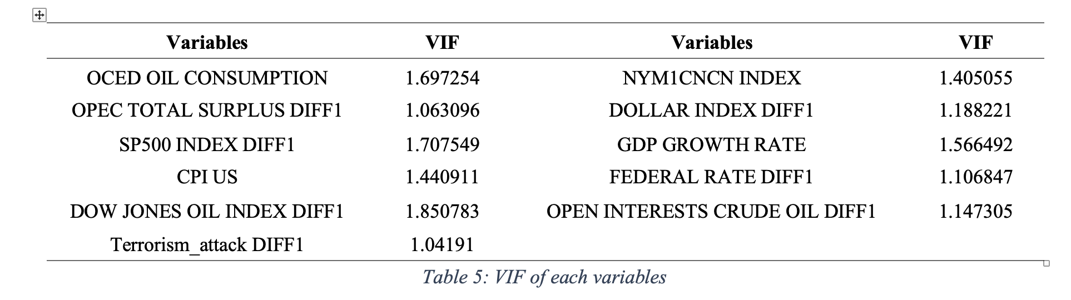
Model Assumption

Slide 12
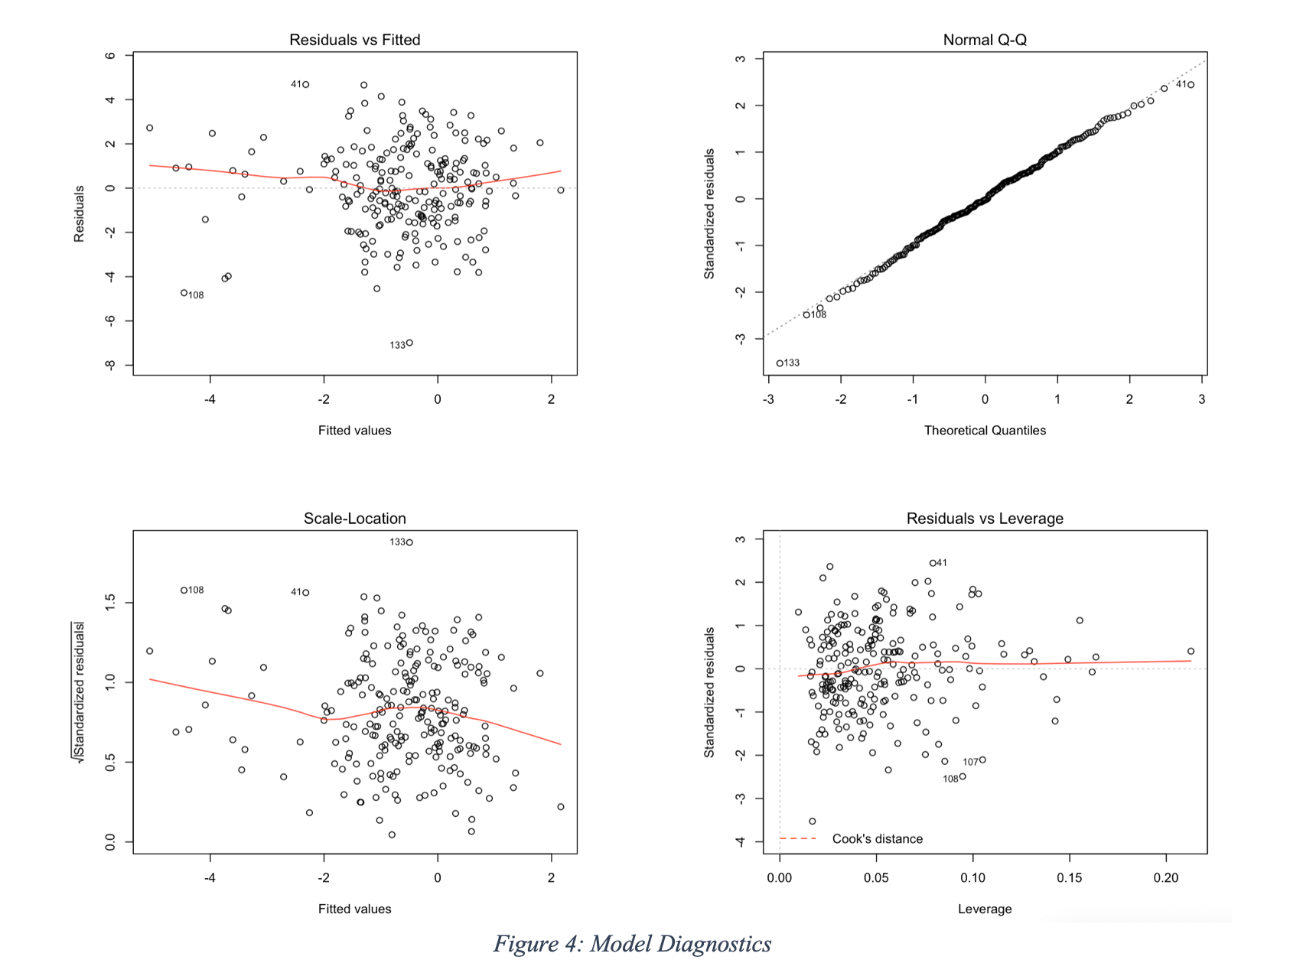
Model Assumption:
Normal error
Homoscedastic

Slide 13
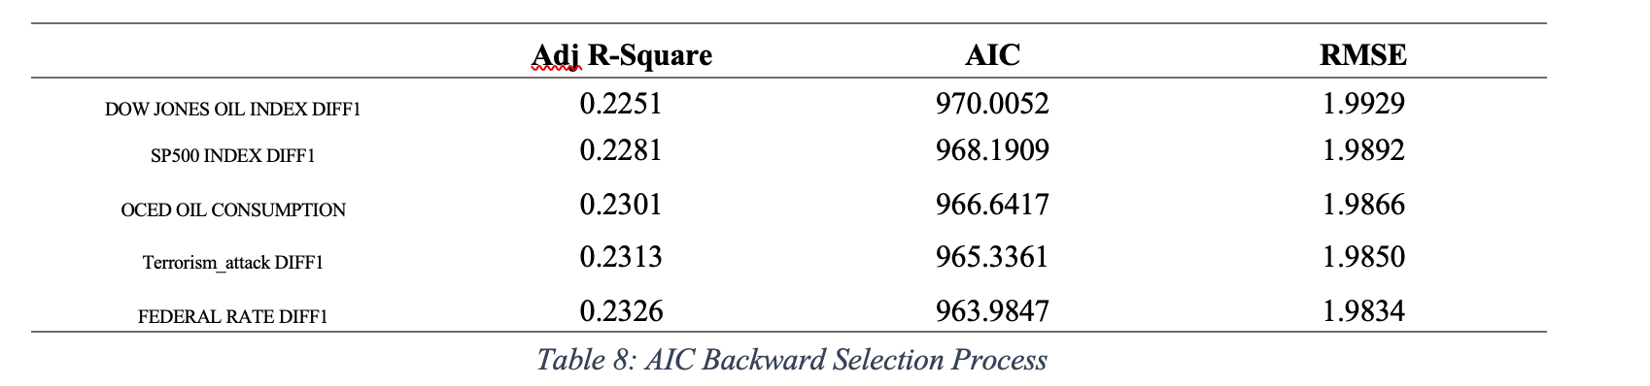
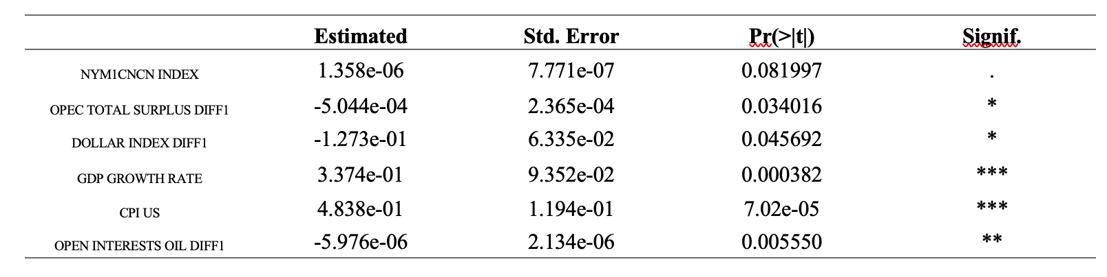
Dimension Reduction - AIC Backward

Slide 14
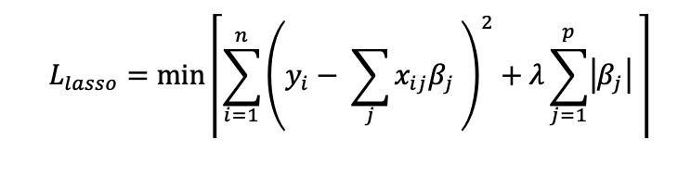
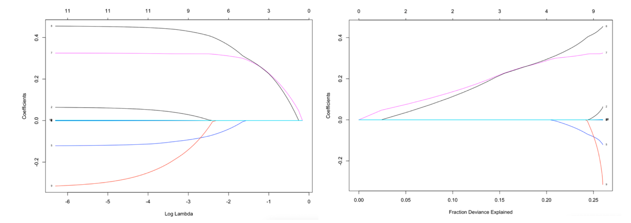
Dimension Reduction - LASSO

Slide 15
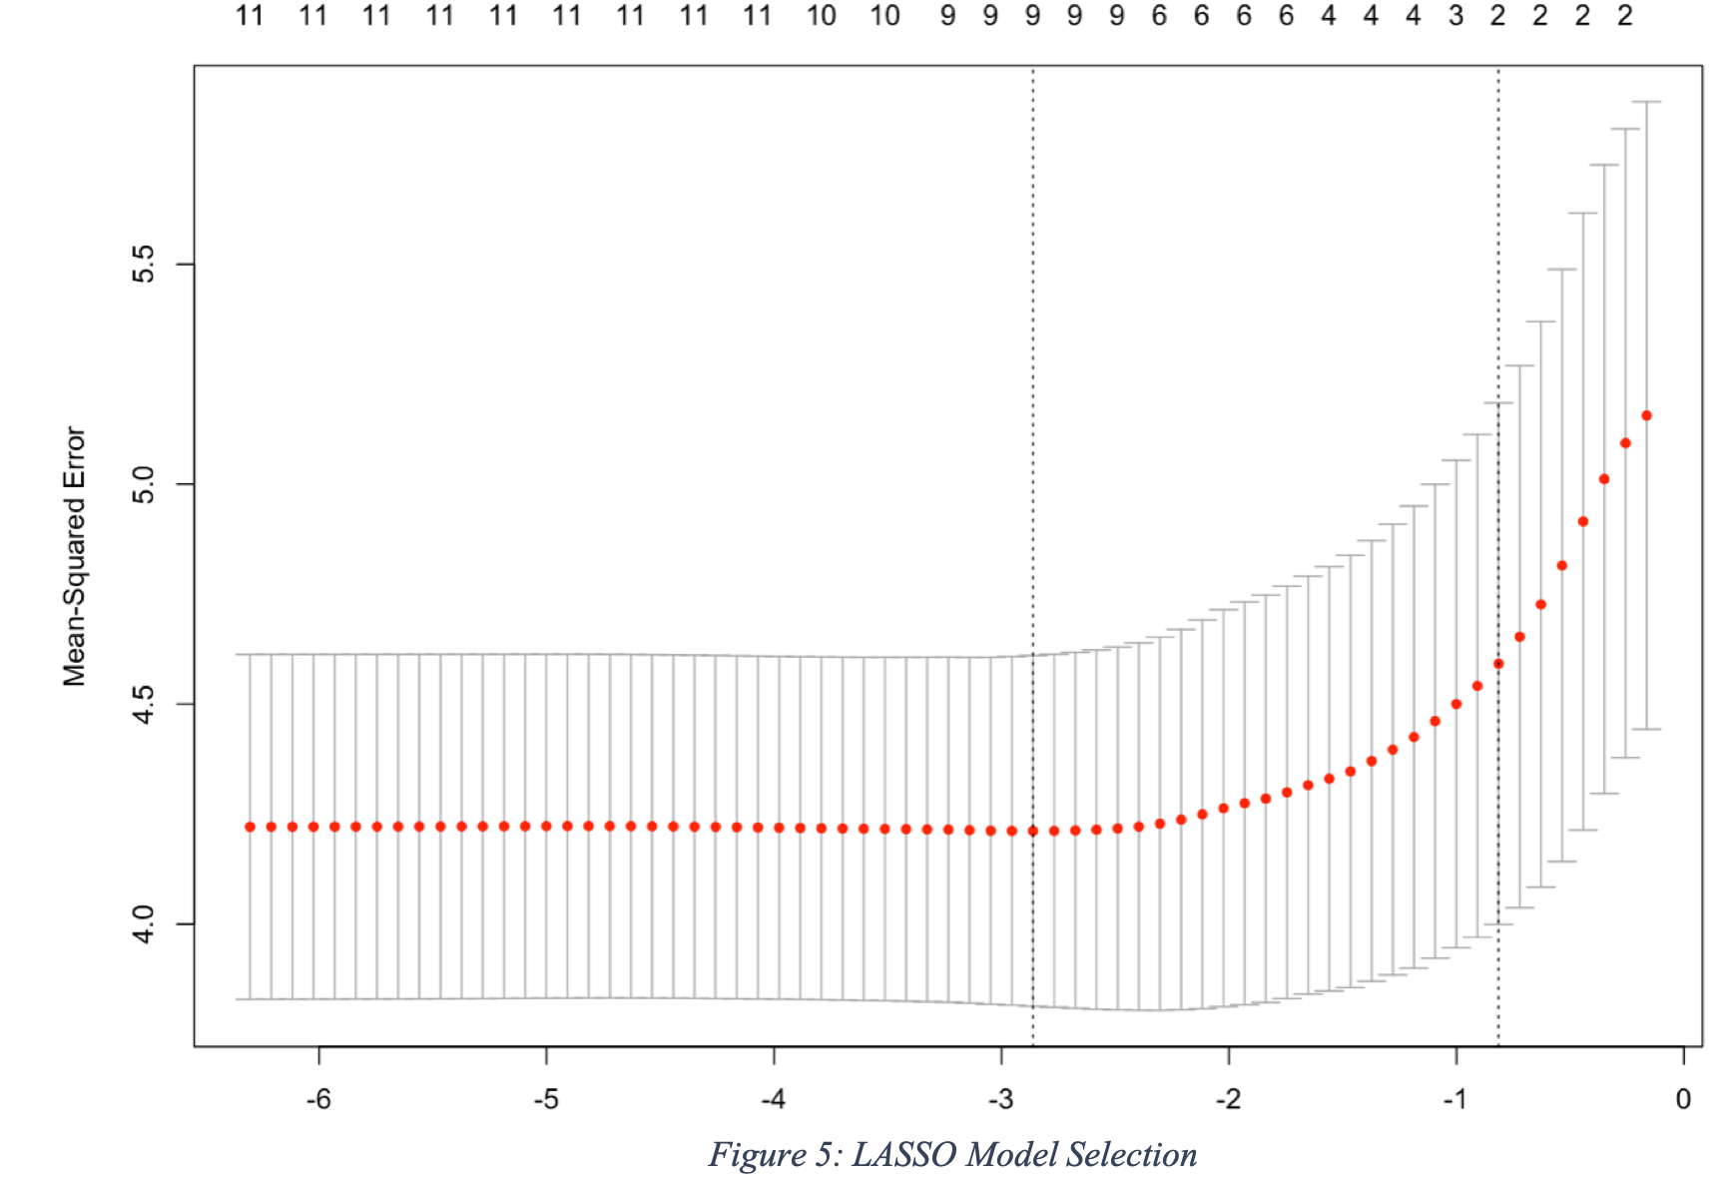
Dimension Reduction - LASSO

Slide 16
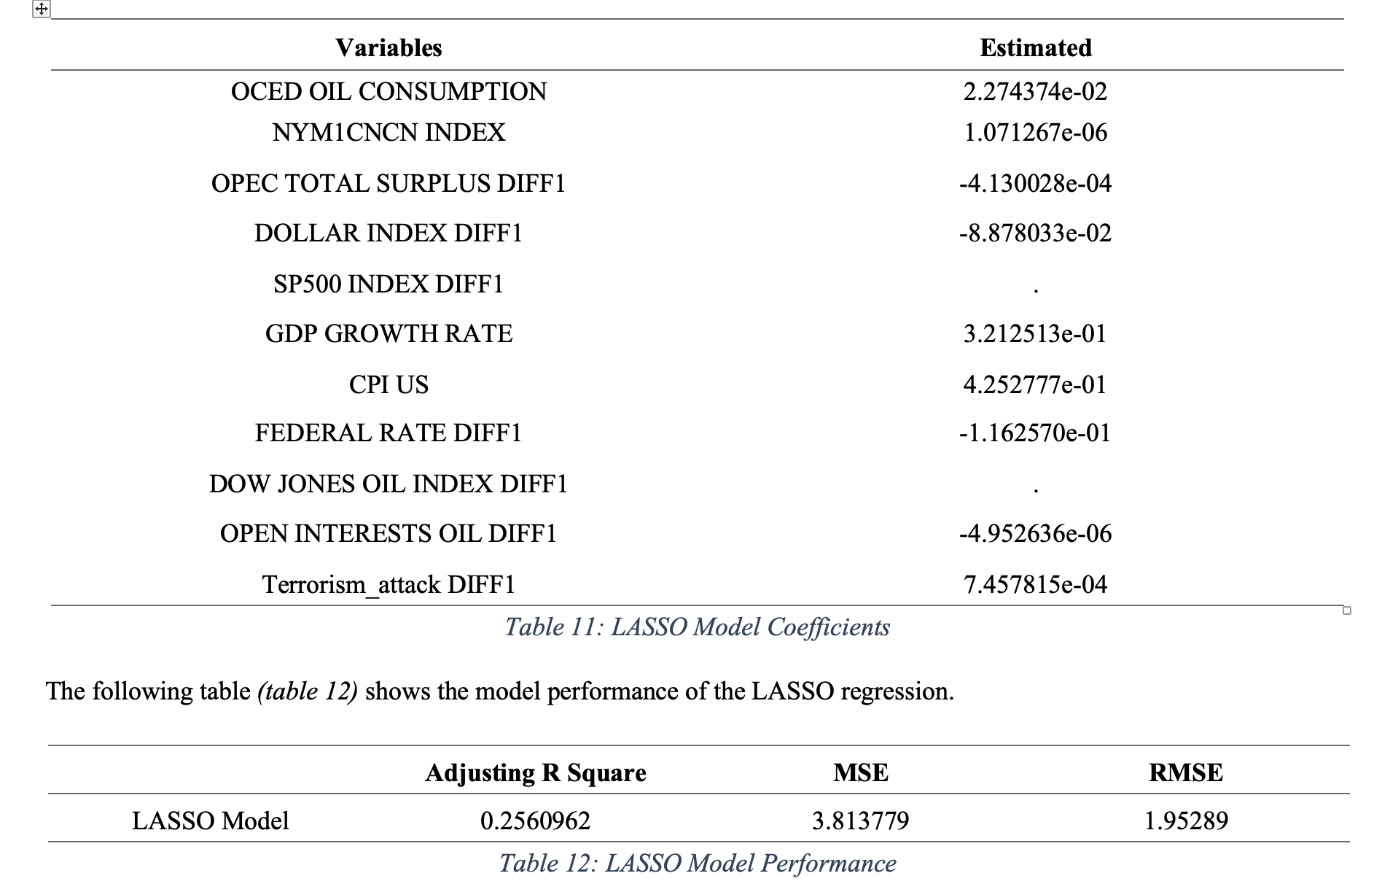
Dimension Reduction - LASSO

Slide 17
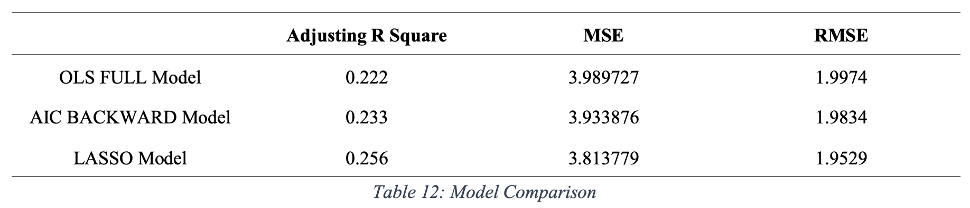
Model Comparison

Slide 18
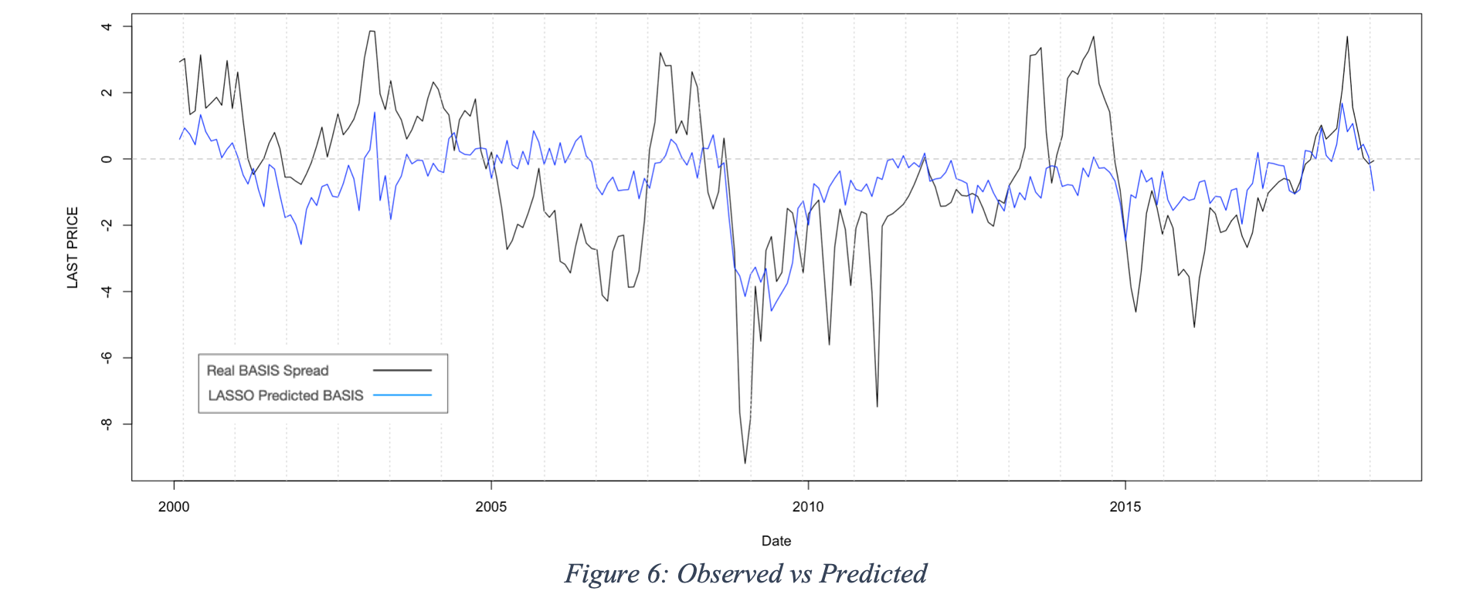
Main Finding / Discussion

Slide 19
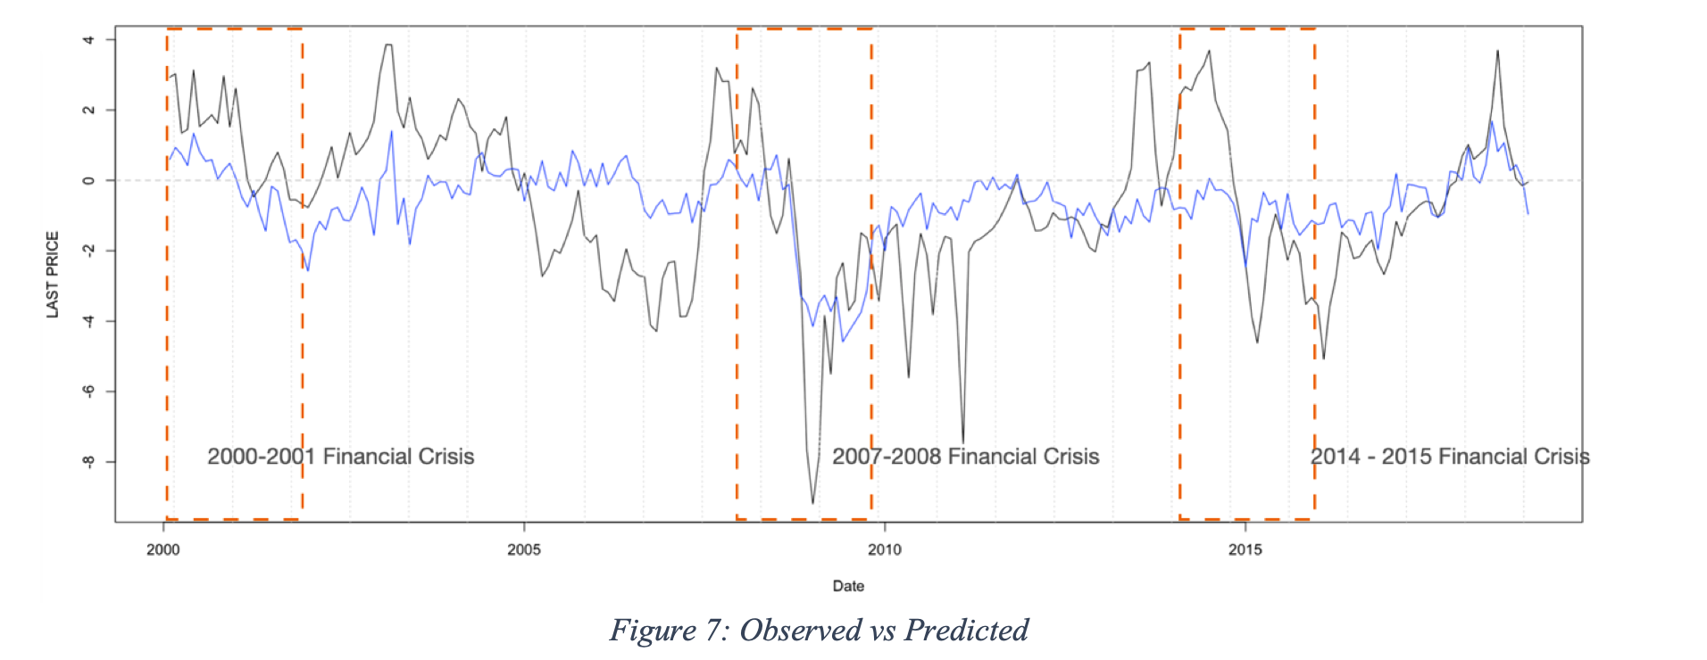
Main Finding / Discussion

Slide 20
Conclusion / Further Thinking
The final result shows that the LASSO model has the best model performance, which can explain 26% of the basis variability with the lowest root mean square error. The adjusting R square is a little bit higher than the empirical value of 25% for times-series and stationary explanatory variables. As a result, the LASSO regression model can be considered as a quite good model.
we can find the LASSO regression model does not do well in predicting the relatively large spread.
By comparing the predicted basis and real basis, we have seen that the predictive model is powerful to predict the movement direction or even the basis spread when there is a significant event in the world market.
The time period during the three main financial crises in 21 century shows strong evidence that the predicted model is more accurate when there are influential events. For the other side, it more likely to indicate that the WTI crude oil basis spread is predictable when there is an influential event. However, if there are not influential factors in the market, the predicted basis spread becomes inaccurate and more like random work.
Due to COVID-19, the financial market has been suffered for some time. As a result, further research can conduct more research about how basis of crude oil is driven by the COVID-19. In this research, we used the data ranged from January 2000 to December 2018 excluding the driven power by COVID-19. However, by applying the LASSO predictive model to the data during COVID-19, we have found the huge error and smallest adjusting R square. It may indicate the further research should separate their data and observe the COVID-19’ effect respectively. Moreover, further research also can be conducted to use the non-linear way to predict the basis of WTI crude oil.

Slide 21
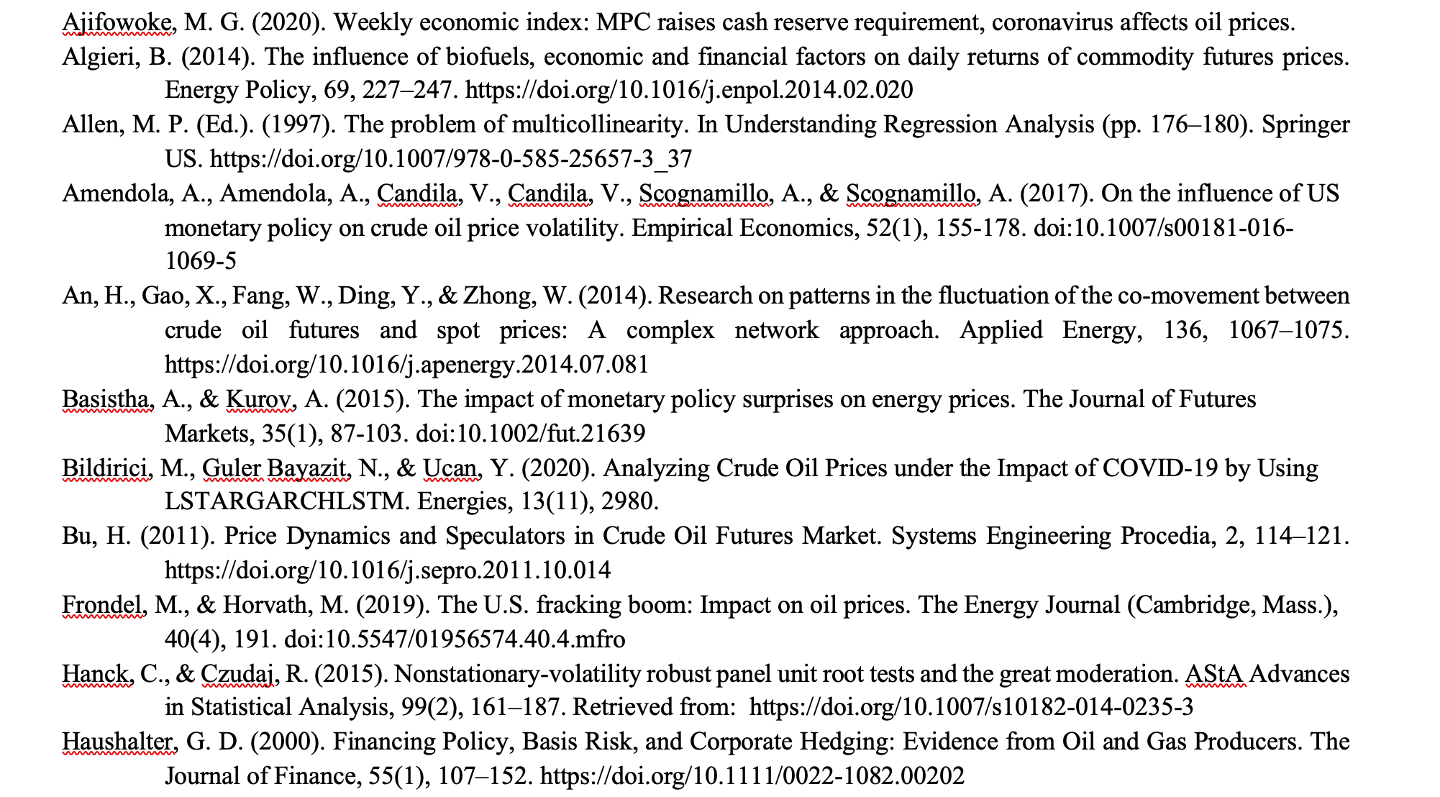
Reference

Slide 22
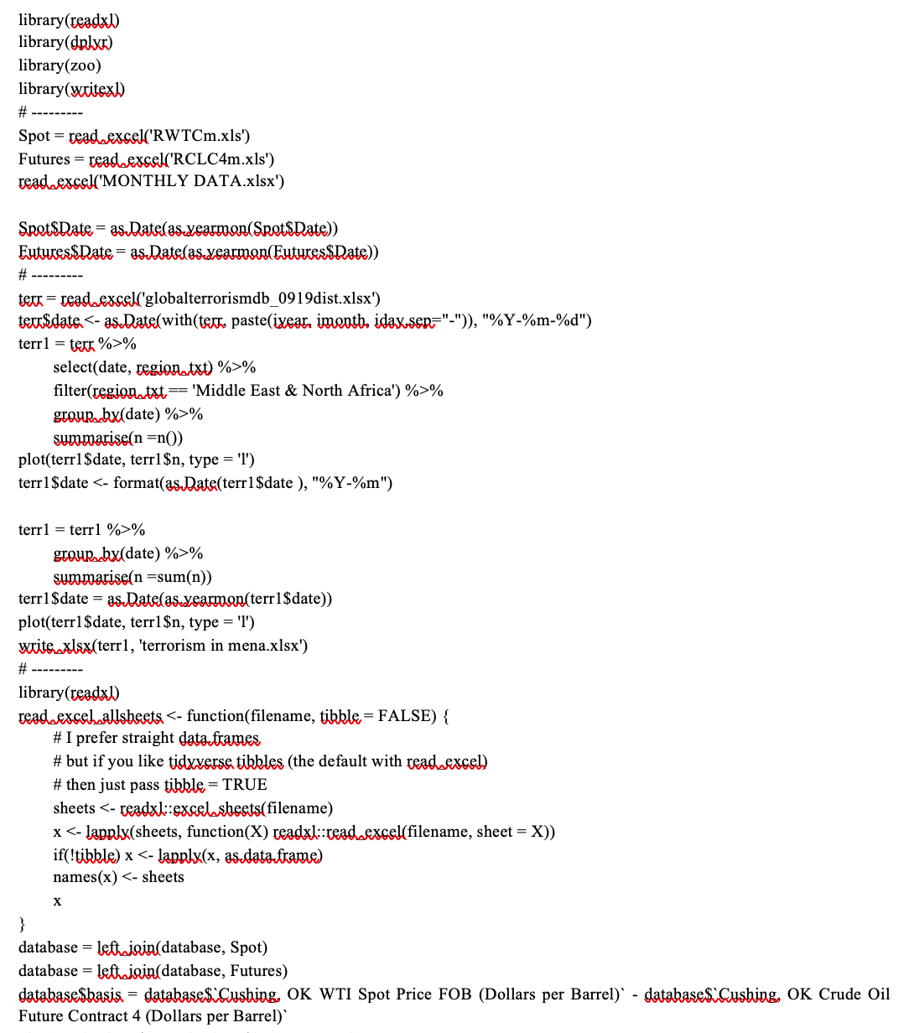
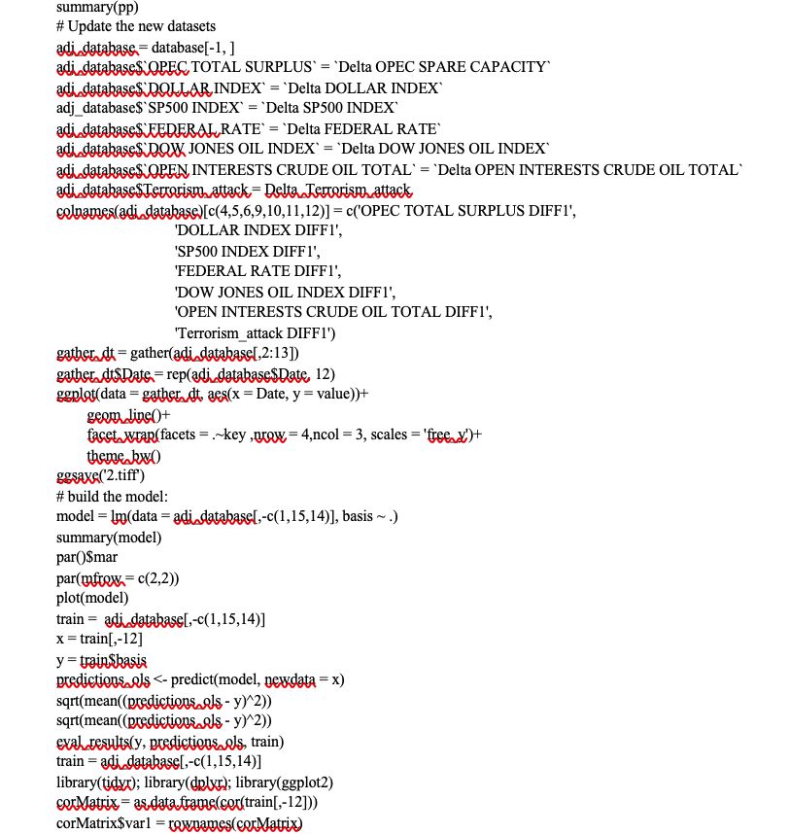
R Code to realize the result

